Slide 1


Slide 2


DEPARTMENT OF ELECTRONICS AND COMMUNICATION ENGINEERING
Automated Hygiene Management System for Public
Restrooms and Septic Tanks
Team Members
Sujitha.G (927622BEC220)
Swetha.K (927622BEC227)
Swathi.R (927622BEC226)
Varshini.S (927622BEC242)
Guided by :Dr.K.Sheikdavood

Slide 3

PROBLEM STATEMENT
Public restrooms and septic tanks have hygiene issues due to manual cleaning and odor control

Slide 4

OBJECTIVE
Automatic Cleaning Efficiency
High-Pressure Pumps
Odor-Integrated Sensors
Real-Time Monitoring
Overflow Prevention
User-Friendly Interface
Low Maintenance

Slide 5
ABSTRACT
Reduce-Health Hazards
Cost-Effective Solution
Compact and Portable
Simple Installation Process
Customizable Features Available
Hygienic Restrooms
Enhanced User Experience

Slide 6
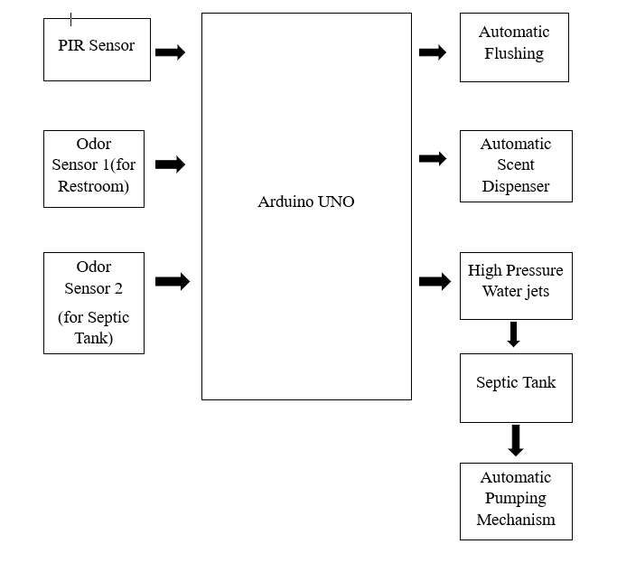
BLOCK DIAGRAM

Slide 7
FLOW CHART

Slide 8

LITERATURE SURVEY
Manual septic cleaning is labor-intensive and unsafe.
Existing odor control methods only mask the smell temporarily.
Current systems lack automatic overflow prevention.
Manual methods waste resources and are inefficient.

Slide 9
WORK PLAN
September:Research the components required for the project.
List out all the necessary component.
Purchase the components.
October (1st Half):Build the circuit diagram.Prepare the code.
October (2nd Half):Connect the components on a breadboard.
Dump the code into the microcontroller.
Start testing the project.
November:Apply the system for real-time use.
Analyze and make any final adjustments if needed.

Slide 10
REFERENCE
https://issuu.com/devanshimehra/docs/thesis_project_2016__foley_designs__22bece38f8e7d0
https://www.researchgate.net/publication/363265900_AUTOMATIC_TOILET_BOWL_CLEANER_1_2_3_4

Slide 11





THANK YOU

